Slide 1

Dynamic Access Provisioning
Team
Pramod Shanbhag
Abhilash R
Harish Reddy V.
Madhusudhan S.

Slide 2
Problem
Selective Access Provisioning
Employees should have access to servers & internet, while the guests should have internet-only access
Selective Access Control
Allowing only guest access for few hours
Access control using ‘MACs’ and ‘IPs‘
Allow ‘172.10.176.25’ or block ‘5e:ee:75:63:9f:ac’
No centralized view of the Access Network

Slide 3
Solution
Admin defines the Access Policies for Users and User Groups through the Admin UI.
User trying to access network is redirected to Authentication Server. The packet redirection is done using header re-write flows.
Authentication server informs SDN Controller on successful authentication using REST APIs.
SDN Controller provisions and manages Access based on defined Access Policies by programming the flows.

Slide 4
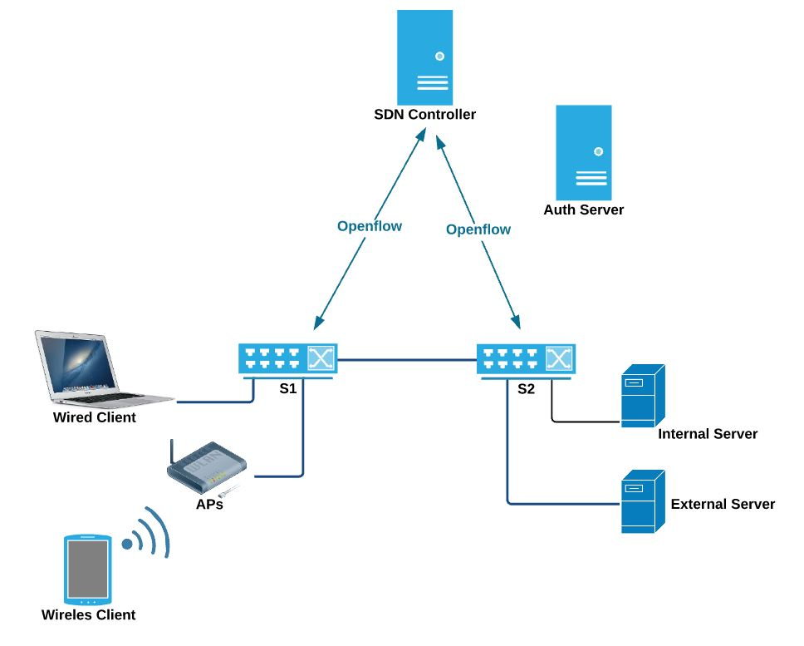



Solution Details - Architecture

Slide 5
Demo Details
Covered the following Use Cases:
Admin creates Guest and Employee and defines the Access Policies.
After authentication, with Guest login, users can only access the external server
After authentication, with Employee login, users can access both the internal and external server
Admin deletes the Guest user ID and guest will not be able to access the network.

Slide 6
Key Takeaways
Policy Based Access Provisioning
Role based access – Access the same network differently by Employees and Guests.
Dynamic Access Control
Manage the Guest access with check-in/check-out
‘User’ Centric Policies
Manage policies for Users and User Groups – not MACs or IP addresses
Centralized Network Surveillance
Centralized monitoring for Intrusion
REST API based approach, so it can be integrated with other solutions.

Slide 7
Key Takeaways
Future :
Programmable Firewall
Access ‘changes’ at different times of a day.
Access ‘changes’ for ‘selective slice’
BYOD
‘Same’ User Policies for ‘All’ his devices

Slide 8
For more information:
https://github.com/onfsdn/acess_prov
faucet-dev@openfloorsdn.org

Slide 9
Q & A

